Slide 1


WSQ COURSE SLIDES
AI Agents with Gemini Spark
Agent strategy · vibe coding · human review · governed automation
Course Code: TGS-2026064173
Version v1.0 · 23 August 2026
Tertiary Infotech Academy Pte Ltd · UEN 201200696W
© 2026 Tertiary Infotech Academy Pte Ltd

Slide 2
00
COURSE ADMINISTRATION
Welcome and Operating Boundaries
Everything needed before the technical learning begins
AI Agents with Gemini Spark · TGS-2026064173
© 2026 Tertiary Infotech Academy Pte Ltd
2

Slide 3
TRAQOM · SSG
Digital Attendance (Mandatory)
1
AM attendance
Scan the trainer-provided TRAQOM QR code when class begins.
2
PM attendance
Complete the second attendance after lunch.
3
Assessment attendance
Complete the assessment attendance before the PP begins.
4
Funding control
At least 75% attendance and competency in all assessments are required.
AI Agents with Gemini Spark · TGS-2026064173
© 2026 Tertiary Infotech Academy Pte Ltd
3

Slide 4
COURSE ADMINISTRATION
About the Trainer
NAME
________________________________________
?
DESIGNATION
________________________________________
QUALIFICATIONS
________________________________________
Your Trainer
EXPERTISE
________________________________________
General Trainer template
EXPERIENCE
________________________________________
CONTACT
________________________________________
AI Agents with Gemini Spark · TGS-2026064173
© 2026 Tertiary Infotech Academy Pte Ltd
4

Slide 5
COURSE ADMINISTRATION
About the Trainer
ROLE
Principal trainer and courseware architect
AA
QUALIFICATIONS
Doctorate; ACTA/DACE-qualified adult educator
EXPERTISE
AI agents, cloud automation, software engineering and digital learning
Dr. Alfred Ang
DELIVERS
Technical WSQ programmes and applied workplace labs
Principal Trainer · Tertiary Infotech Academy
ORGANISATION
Tertiary Infotech Academy Pte Ltd
CONTACT
enquiry@tertiaryinfotech.com
AI Agents with Gemini Spark · TGS-2026064173
© 2026 Tertiary Infotech Academy Pte Ltd
5

Slide 6
ICEBREAKER
Learner Introductions
1
Your role
What work do you own today?
2
Your repetitive task
Which workflow consumes time or attention?
3
Your web goal
What should the website help a visitor accomplish?
4
Your risk boundary
Which action should always need human approval?
AI Agents with Gemini Spark · TGS-2026064173
© 2026 Tertiary Infotech Academy Pte Ltd
6

Slide 7
WORKING AGREEMENT
Ground Rules
1
Participate
Ask questions and share evidence, not credentials.
2
Protect data
Use mock data and provided accounts only.
3
Work in small changes
Review every meaningful patch before continuing.
4
Keep control
Stop an agent that exceeds the approved plan.
5
Return on time
Breaks are short in this one-day programme.
6
Respect ownership
Do not publish, send or transact without approval.
AI Agents with Gemini Spark · TGS-2026064173
© 2026 Tertiary Infotech Academy Pte Ltd
7

Slide 8
FOUR TECHNICAL BLOCKS
Course Outline
1
Agent Strategy and Gemini Spark Runtime
LO1 · K1, A1
2
Vibe Coding a Responsive Website
LO2 · K4, K5, A2
3
Skills, Schedules and Implementation Governance
LO3 · K3, K5, A3
4
Monitoring, Incident Control and Optimisation
LO4 · K2, K6, A4
AI Agents with Gemini Spark · TGS-2026064173
© 2026 Tertiary Infotech Academy Pte Ltd
8

Slide 9
SCHEDULE
One-Day Lesson Plan
Time
Learning block
Evidence
09:20-11:20
Agent strategy + Lab 1
Strategy and approval map
11:20-13:40
Vibe coding + Lab 2
Responsive website and test log
13:40-15:30
Skills/schedules + Lab 3
Skill and implementation plan
15:30-16:30
Monitoring + Lab 4
Scorecard and incident record
16:40-18:00
PP + OQ
A1-A4 and K1-K6 evidence
DECISION RULE Detailed procedures remain in the Learner Guide and lab folders.
AI Agents with Gemini Spark · TGS-2026064173
© 2026 Tertiary Infotech Academy Pte Ltd
9

Slide 10
WHAT YOU WILL BE ABLE TO DO
Learning Outcomes
1
LO1
Determine an AI-agent strategy by translating a web-design goal into bounded tasks, permissions, risks and human approval points.
2
LO2
Develop web content and a responsive website through a controlled vibe-coding loop using Claude Code, Codex or Antigravity, with Gemini Spark supporting research and reusable skills.
3
LO3
Develop an implementation plan for Gemini Spark tasks, skills, schedules and connected tools, including responsibilities, timelines and rollback controls.
4
LO4
Evaluate agent and website performance using evidence, acceptance criteria, incident signals and iterative improvement decisions.
AI Agents with Gemini Spark · TGS-2026064173
© 2026 Tertiary Infotech Academy Pte Ltd
10

Slide 11
LMS / TMS
Download Course Materials
1
LMS course record
The verified course links are stored at lms-tms.tertiaryinfotech.com.
2
Learner Guide
Use the detailed procedures, prompts, evidence rules and acceptance checks.
3
Learner slides
Use the PDF for concepts, visual models and assessment alignment.
4
Hands-on labs
Get the self-contained lab folders from the linked GitHub repository.
https://lms-tms.tertiaryinfotech.com/
AI Agents with Gemini Spark · TGS-2026064173
© 2026 Tertiary Infotech Academy Pte Ltd
11

Slide 12
GITHUB LABS
Access the Hands-On Labs
1
Option A · Clone
git clone https://github.com/tertiarycourses/TGS-2026064173-AI-Agents-with-Gemini-Spark.git
2
Option B · Download
GitHub → Code → Download ZIP
3
Lab structure
Each lab is self-contained with files, evidence and acceptance checks.
4
Coding choice
Use Claude Code, Codex or Antigravity; record which one you chose.
https://github.com/tertiarycourses/TGS-2026064173-AI-Agents-with-Gemini-Spark
AI Agents with Gemini Spark · TGS-2026064173
© 2026 Tertiary Infotech Academy Pte Ltd
12

Slide 13
ASSESSMENT RULES
Briefing for Assessment
1
Individual
Complete the PP and OQ independently.
2
Open book
Use the slides, Learner Guide and approved lab files.
3
Evidence
Submit the requested artifacts and answer each criterion.
4
Competency
Every A and K criterion must be assessed competent.
5
No sharing
Do not photograph or circulate assessment scripts.
6
Appeal
The assessor will explain the feedback and appeal process.
AI Agents with Gemini Spark · TGS-2026064173
© 2026 Tertiary Infotech Academy Pte Ltd
13

Slide 14
PP + OQ
Assessment Design
1
Practical Performance
4 tasks · A1-A4 · 60 minutes
2
Oral Questioning
4 questions · K1-K6 · 20 minutes
3
Submission
Candidate papers are completed on the LMS.
4
Privacy
Answer keys remain trainer-only and are never published.
AI Agents with Gemini Spark · TGS-2026064173
© 2026 Tertiary Infotech Academy Pte Ltd
14

Slide 15
ASSESSMENT CONTROL
Assessment Flow
1
2
3
4
5
TRAQOM attendance
Practical Performance
Oral Questioning
Submit on LMS
Sign assessment record
THE POINT PP covers A1-A4; OQ covers K1-K6; all criteria must be competent.
AI Agents with Gemini Spark · TGS-2026064173
© 2026 Tertiary Infotech Academy Pte Ltd
15

Slide 16
00
CORE MECHANISMS
From Chatbot to Governed Agent
The technical distinctions that make the rest of the course work
AI Agents with Gemini Spark · TGS-2026064173
© 2026 Tertiary Infotech Academy Pte Ltd
16

Slide 17
RUNTIME MODEL
Chatbot, Assistant and Agent
Property
Chatbot
Agent
Control loop
Prompt → response
Goal → plan → act → observe → revise
State
Conversation context
Task thread, files, schedules and tool results
Tools
Optional retrieval
Connected apps, browser and code execution
Time
Ends with response
May continue in background or on a trigger
Risk
Wrong answer
Wrong action or repeated wrong action
DECISION RULE Treat every tool action as a state change that needs evidence and a recovery route.
AI Agents with Gemini Spark · TGS-2026064173
© 2026 Tertiary Infotech Academy Pte Ltd
17

Slide 18
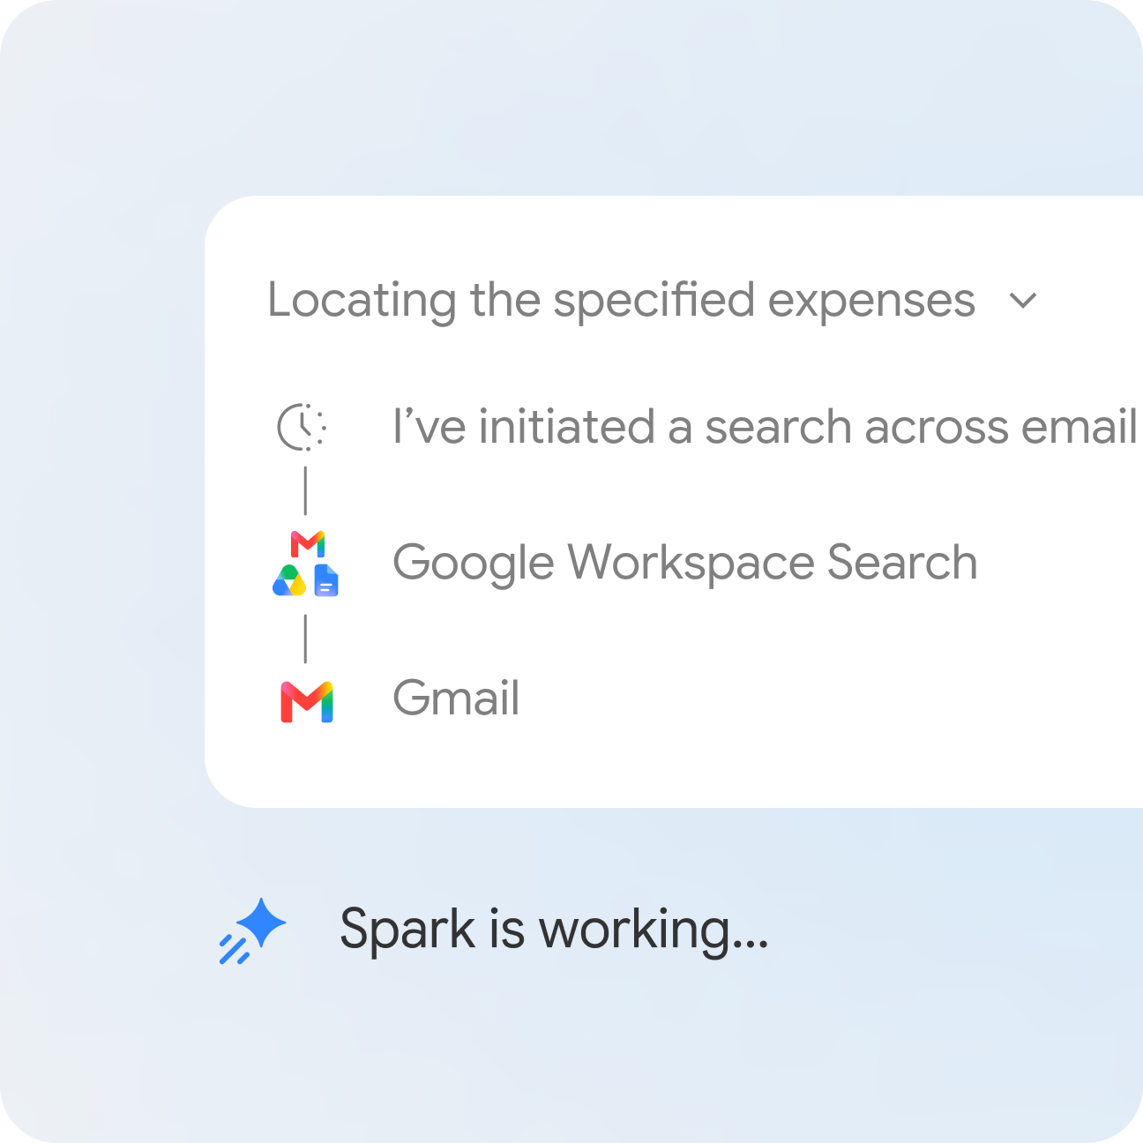
OFFICIAL PRODUCT EVIDENCE
Gemini Spark: Tasks, Skills and Schedules
READ THE VISUAL
Tasks define what, skills define how, and schedules define when. Connected apps provide the action surface; the task thread and work panel preserve observable progress.
AI Agents with Gemini Spark · TGS-2026064173
© 2026 Tertiary Infotech Academy Pte Ltd
Source ↗
18

Slide 19
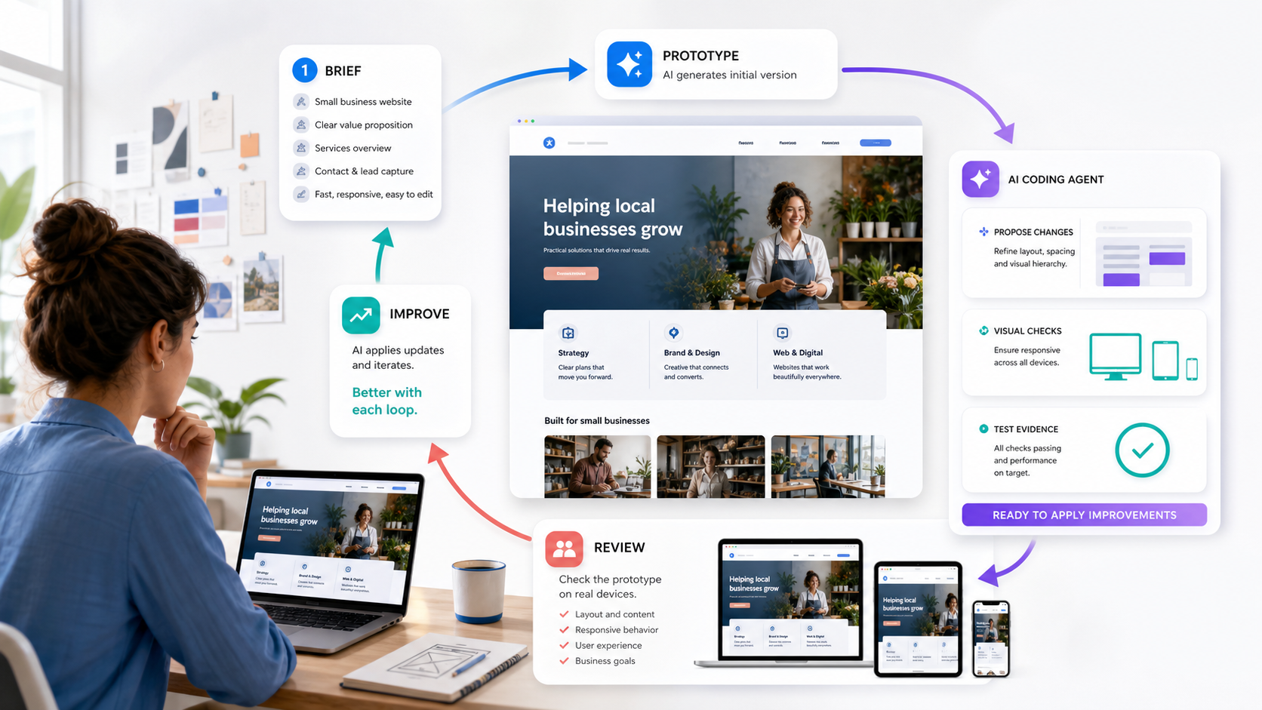
WEB DESIGN
The Vibe-Coding Loop
READ THE VISUAL
A useful loop is brief → thin prototype → diff review → browser checks → owner review → one controlled improvement. The human owns intent and acceptance.
AI Agents with Gemini Spark · TGS-2026064173
© 2026 Tertiary Infotech Academy Pte Ltd
19

Slide 20
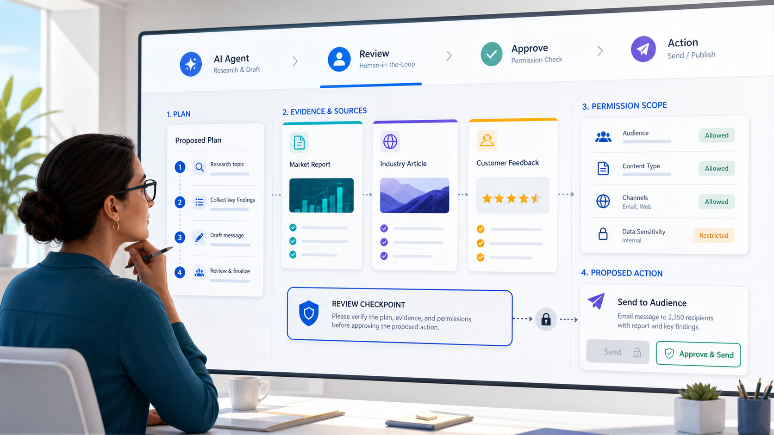
GOVERNANCE
Human-in-the-Loop Is a Control System
READ THE VISUAL
The reviewer checks plan, evidence, permissions and consequence before the final action. A decorative approve button is not enough; the evidence and rollback route must be visible.
AI Agents with Gemini Spark · TGS-2026064173
© 2026 Tertiary Infotech Academy Pte Ltd
Source ↗
20

Slide 21
CURRENT LIMITS
Product Constraints That Change the Design
Constraint
Current product evidence
Design consequence
Account
Personal Google Account; Pro or Ultra; Keep Activity on
Prepare a fallback simulation for learners without access
Availability
Feature availability varies by region and platform
Do not make course completion depend on one live screen
Concurrency
Up to 15 tasks may run at once
Use deduplication and no-overlap schedules
Sensitive data
Do not type sign-in or payment data into the task thread
Use takeover and enter it on the website directly
Safety
Experimental feature; supervision remains important
Require review gates and safe stop conditions
DECISION RULE Verify live access before class; use the supplied offline artifacts when Spark is unavailable.
Google Help source ↗
AI Agents with Gemini Spark · TGS-2026064173
© 2026 Tertiary Infotech Academy Pte Ltd
21

Slide 22
01
TOPIC 01 · LO1 · K1, A1
Agent Strategy and Gemini Spark Runtime
Goal contract - task plan - tools - state - approval - evidence
AI Agents with Gemini Spark · TGS-2026064173
© 2026 Tertiary Infotech Academy Pte Ltd
22

Slide 23
DESIGN PRINCIPLE
Agent Strategy and Gemini Spark Runtime
Autonomy is safe only when the goal, permission boundary, evidence and stop conditions are explicit.
Use this as the design test for every mechanism, task and lab artifact in this topic.
AI Agents with Gemini Spark · TGS-2026064173
© 2026 Tertiary Infotech Academy Pte Ltd
23

Slide 24
TOPIC 01 · COMPONENT MODEL
Architecture and Trust Boundaries
1
Task thread
Holds the goal, instructions, files and task state.
2
Planner
Decomposes the goal into observable steps and revises when blocked.
3
Skills
Reusable how-to instructions and context, selected explicitly or automatically.
4
Connected tools
Workspace apps, websites, local or remote browser, and code execution.
5
Human control
Review, confirm, take over, stop, pause schedules and inspect changed files.
AI Agents with Gemini Spark · TGS-2026064173
© 2026 Tertiary Infotech Academy Pte Ltd
Source ↗
24

Slide 25
TOPIC 01 · EXECUTION
Runtime Trace
1
2
3
4
5
State the outcome
Inspect context
Propose a plan
Use bounded tools
Return evidence
THE POINT A task is observable only when each stage exposes inputs, state, output and the next decision.
AI Agents with Gemini Spark · TGS-2026064173
© 2026 Tertiary Infotech Academy Pte Ltd
25

Slide 26
TOPIC 01 · REQUIRED FIELDS
The Concrete Contract
1
Goal
One measurable business outcome; avoid vague verbs such as improve or optimise.
2
Scope
Named apps, folders, sites, audience, date range and excluded data.
3
Output
Exact artifact, schema, destination and quality threshold.
4
Control
Approval gates, stop rules, rollback owner and escalation path.
AI Agents with Gemini Spark · TGS-2026064173
© 2026 Tertiary Infotech Academy Pte Ltd
26

Slide 27
TOPIC 01 · DECISION TABLE
Make the Choice Explicit
Property
Option A
Option B
Trigger
User prompt
Time or event
Persistence
Single task thread
Runs repeatedly until paused
Best fit
Bounded deliverable
Stable recurring operation
Primary risk
Misread intent
Unobserved repeated error
DECISION RULE Choose the lowest-autonomy pattern that still meets the business outcome.
AI Agents with Gemini Spark · TGS-2026064173
© 2026 Tertiary Infotech Academy Pte Ltd
27

Slide 28
TOPIC 01 · FAILURE CONTROL
Failure → Diagnostic → Control
Failure
Observable diagnostic
Control / recovery
Goal drift
Plan no longer serves the stated business outcome
Restate acceptance criteria and cancel non-essential branches
Permission creep
Agent requests broader access mid-task
Deny, narrow the task, and document the exception
Hidden dependency
Website, login or file is unavailable
Stop and request takeover; do not improvise credentials
Weak evidence
Agent reports success without artifact or trace
Require links, filenames, before/after state and validation
DECISION RULE Stop on ambiguous authority; do not hide a partial or failed state.
AI Agents with Gemini Spark · TGS-2026064173
© 2026 Tertiary Infotech Academy Pte Ltd
28

Slide 29
TOPIC 01 · CASE
Worked Case: Northstar Studio
1
Business context
A local design studio needs a lead-generation website. Spark may research competitors and organise source material, while the coding agent builds locally. Publishing, form submission and customer communications remain human-approved actions.
2
Human owner
Approves sources, claims, permissions and any public action.
3
Agent boundary
Researches, drafts, edits or analyses only within the approved contract.
4
Evidence package
Plan, diff, files, tests, source log, approval and rollback point.
AI Agents with Gemini Spark · TGS-2026064173
© 2026 Tertiary Infotech Academy Pte Ltd
29

Slide 30
TOPIC 01 · EDITABLE CHART
Worked example: risk rises with autonomy and data sensitivity
HOW TO READ IT
1. Values are an illustrative worked example.
2. Compare relative risk or improvement, not industry benchmarks.
3. Use your own run evidence to replace these values.
AI Agents with Gemini Spark · TGS-2026064173
© 2026 Tertiary Infotech Academy Pte Ltd
30

Slide 31
TOPIC 01 · CONTROL MODEL
Control Points Across the Lifecycle
1
Before
Validate goal, inputs, access and risk tier.
2
During
Observe progress, changed files, tool use and confirmation requests.
3
Before consequence
Require human review for communications, publishing, payments and sensitive edits.
4
After
Read back the external state, store evidence and schedule the next review.
AI Agents with Gemini Spark · TGS-2026064173
© 2026 Tertiary Infotech Academy Pte Ltd
31

Slide 32
TOPIC 01 · HUMAN GATE
When May the Agent Continue?
Is authority clear, risk bounded, and evidence visible?
YES · Continue one bounded step and re-check the evidence.
NO · Stop, take over or request a narrower instruction.
AI Agents with Gemini Spark · TGS-2026064173
© 2026 Tertiary Infotech Academy Pte Ltd
32

Slide 33
TOPIC 01 · VERIFICATION
Evidence Is a Data Model
1
Input evidence
Approved brief, source list, version and permission scope.
2
Process evidence
Plan, task progress, tool calls, changed files and confirmations.
3
Output evidence
Artifact, link, commit, screenshot, test report and source trace.
4
Decision evidence
Reviewer, timestamp, approve/reject reason and rollback target.
AI Agents with Gemini Spark · TGS-2026064173
© 2026 Tertiary Infotech Academy Pte Ltd
33

Slide 34
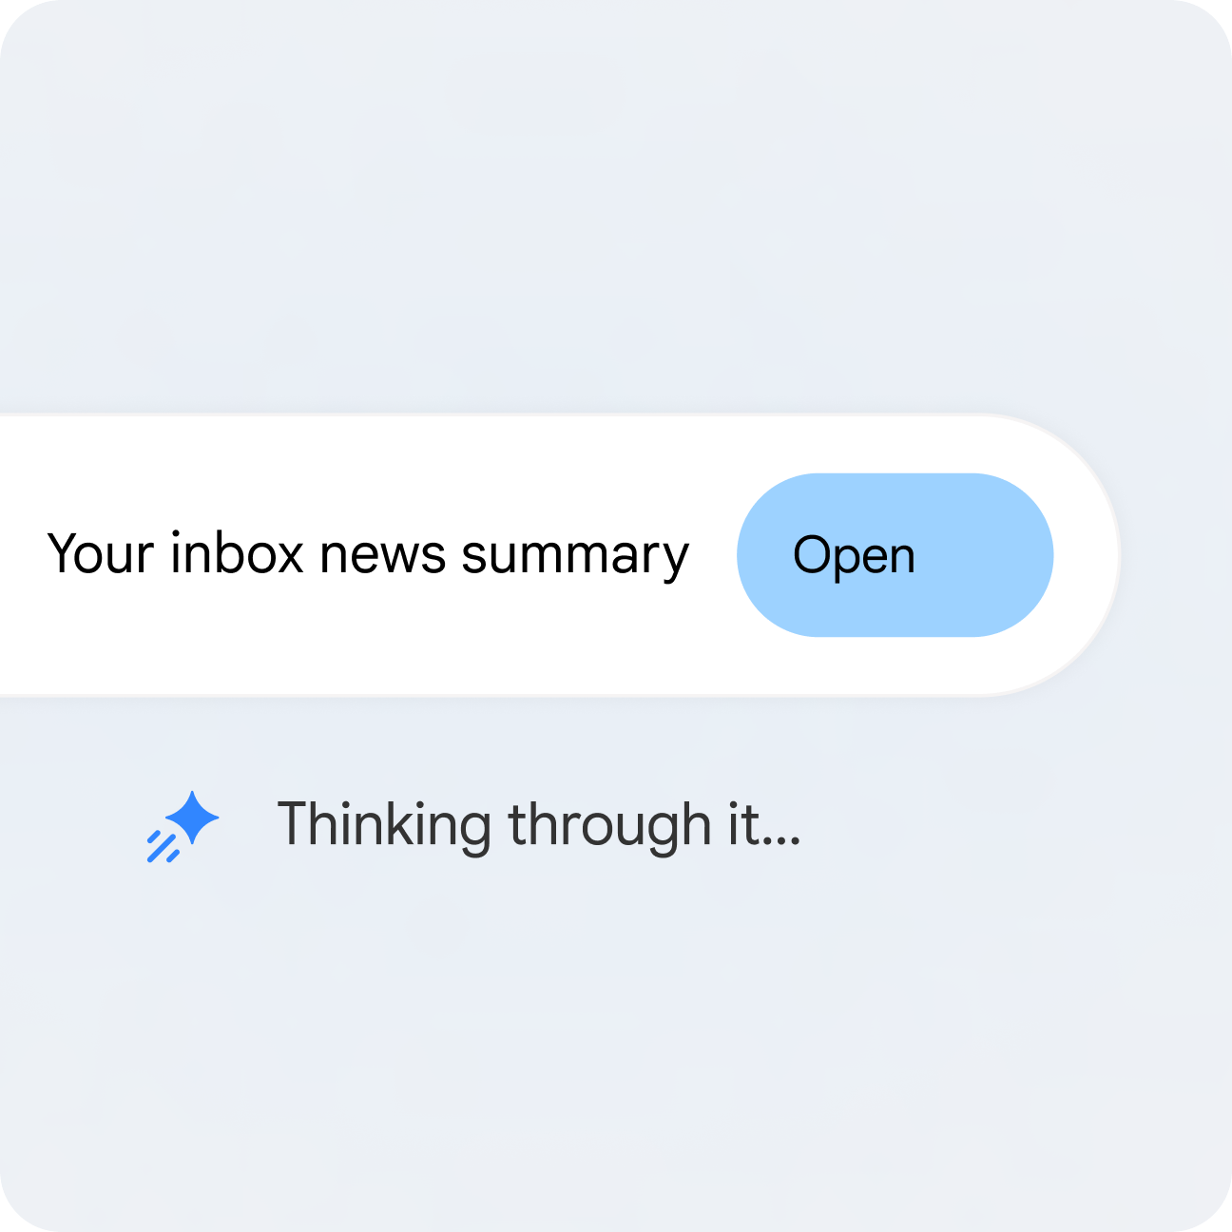
TOPIC 01 · PRODUCT EVIDENCE
Official Spark Example: Inbox Synthesis
READ THE VISUAL
The agent searches a defined information space, synthesises a result and exposes progress. A workplace version still needs source scope, freshness, approval and evidence rules.
AI Agents with Gemini Spark · TGS-2026064173
© 2026 Tertiary Infotech Academy Pte Ltd
Source ↗
34

Slide 35
TOPIC 01 · PRACTICE BRIDGE
Lab 1 · Create the Agent Strategy and Approval Map
1
Scenario
Translate a website goal into a bounded Gemini Spark task with permissions, risk tiers, approval gates and acceptance evidence.
2
Build
A strategy brief, task contract, permission matrix, risk register and human-approval map for the Northstar Studio website.
3
Tools
Gemini Spark task planning, browser research, Google Drive, human review
4
Criteria
A1, K1
AI Agents with Gemini Spark · TGS-2026064173
© 2026 Tertiary Infotech Academy Pte Ltd
35

Slide 36
LAB 1 · EXECUTION MODEL
Lab Mechanism - Not the Click Path
1
2
3
4
5
Read supplied inputs
Create bounded artifact
Review risk and evidence
Test acceptance
Record sign-off
THE POINT The task can be executed without guessing: every step has an owner, allowed tools, a risk tier, approval rule, stop condition and observable completion evidence.
AI Agents with Gemini Spark · TGS-2026064173
© 2026 Tertiary Infotech Academy Pte Ltd
36

Slide 37
LAB 1 · VERIFY
Lab Evidence and Acceptance
1
Primary artifact
A strategy brief, task contract, permission matrix, risk register and human-approval map for the Northstar Studio website.
2
Acceptance test
The task can be executed without guessing: every step has an owner, allowed tools, a risk tier, approval rule, stop condition and observable completion evidence.
3
Assessment bridge
Practical criterion: A1
4
Knowledge bridge
Oral criterion: K1
AI Agents with Gemini Spark · TGS-2026064173
© 2026 Tertiary Infotech Academy Pte Ltd
37

Slide 38
TOPIC 01 · SYNTHESIS
Topic Technical Takeaways
1
Architecture
Holds the goal, instructions, files and task state.
2
Runtime
State the outcome → Inspect context → Propose a plan → Use bounded tools → Return evidence
3
Control
Restate acceptance criteria and cancel non-essential branches
4
Practice
The task can be executed without guessing: every step has an owner, allowed tools, a risk tier, approval rule, stop condition and observable completion evidence.
AI Agents with Gemini Spark · TGS-2026064173
© 2026 Tertiary Infotech Academy Pte Ltd
38

Slide 39
02
TOPIC 02 · LO2 · K4, K5, A2
Vibe Coding a Responsive Website
Brief - prototype - inspect - test - review - improve
AI Agents with Gemini Spark · TGS-2026064173
© 2026 Tertiary Infotech Academy Pte Ltd
39

Slide 40
DESIGN PRINCIPLE
Vibe Coding a Responsive Website
Vibe coding is rapid co-creation with an AI coding agent, disciplined by small changes, executable evidence and human review.
Use this as the design test for every mechanism, task and lab artifact in this topic.
AI Agents with Gemini Spark · TGS-2026064173
© 2026 Tertiary Infotech Academy Pte Ltd
40

Slide 41
TOPIC 02 · COMPONENT MODEL
Architecture and Trust Boundaries
1
Design brief
Audience, job-to-be-done, content, constraints and acceptance tests.
2
Coding agent
Claude Code, Codex or Antigravity edits the repository from natural-language intent.
3
Local project
HTML, CSS, JavaScript, assets, README and version history.
4
Test loop
Open in a browser, check responsive layouts, links, form states and accessibility.
5
Reviewer
Accepts, rejects or redirects each meaningful change before release.
AI Agents with Gemini Spark · TGS-2026064173
© 2026 Tertiary Infotech Academy Pte Ltd
41

Slide 42
TOPIC 02 · EXECUTION
Runtime Trace
1
2
3
4
5
Write the brief
Generate a thin slice
Inspect the diff
Run checks
Approve or iterate
THE POINT A task is observable only when each stage exposes inputs, state, output and the next decision.
AI Agents with Gemini Spark · TGS-2026064173
© 2026 Tertiary Infotech Academy Pte Ltd
42

Slide 43
TOPIC 02 · REQUIRED FIELDS
The Concrete Contract
1
Brief
Who the site is for, what action matters, required sections and content source.
2
Guardrails
No secrets, no unapproved dependencies, no destructive commands, preserve working files.
3
Test
Desktop/mobile widths, keyboard navigation, readable contrast, valid links and form feedback.
4
Handoff
README, file map, known limitations, rollback commit and next review date.
AI Agents with Gemini Spark · TGS-2026064173
© 2026 Tertiary Infotech Academy Pte Ltd
43

Slide 44
TOPIC 02 · DECISION TABLE
Make the Choice Explicit
Dimension
Choice 1
Choice 2
Choice 3
Interaction
Terminal/repository
Agent manager/IDE
Cloud coding workspace
Typical choice
Claude Code
Antigravity
Codex
Strength
Deep local context
Multi-agent orchestration
Sandboxed agentic coding
Review evidence
Diff and commands
Task artifacts
Patch, tests and run log
DECISION RULE Choose the lowest-autonomy pattern that still meets the business outcome.
AI Agents with Gemini Spark · TGS-2026064173
© 2026 Tertiary Infotech Academy Pte Ltd
44

Slide 45
TOPIC 02 · FAILURE CONTROL
Failure → Diagnostic → Control
Failure
Observable diagnostic
Control / recovery
Prompt pile-up
One huge instruction creates many coupled changes
Ask for one thin vertical slice at a time
Visual regression
Desktop improvement breaks mobile
Test at 1440, 768 and 390 px before approval
Plausible content
Agent invents facts, testimonials or prices
Use a supplied content inventory and source every claim
Dependency sprawl
Unnecessary framework or package added
Require a justification and prefer existing stack
DECISION RULE Stop on ambiguous authority; do not hide a partial or failed state.
AI Agents with Gemini Spark · TGS-2026064173
© 2026 Tertiary Infotech Academy Pte Ltd
45

Slide 46
TOPIC 02 · CASE
Worked Case: Northstar Studio
1
Business context
Northstar Studio needs a fast, accessible one-page website with a hero, services, proof, and contact section. The team uses a coding agent for the implementation while Spark organises approved source material and revision requests.
2
Human owner
Approves sources, claims, permissions and any public action.
3
Agent boundary
Researches, drafts, edits or analyses only within the approved contract.
4
Evidence package
Plan, diff, files, tests, source log, approval and rollback point.
AI Agents with Gemini Spark · TGS-2026064173
© 2026 Tertiary Infotech Academy Pte Ltd
46

Slide 47
TOPIC 02 · EDITABLE CHART
Worked example: defects removed by review gates
HOW TO READ IT
1. Values are an illustrative worked example.
2. Compare relative risk or improvement, not industry benchmarks.
3. Use your own run evidence to replace these values.
AI Agents with Gemini Spark · TGS-2026064173
© 2026 Tertiary Infotech Academy Pte Ltd
47

Slide 48
TOPIC 02 · CONTROL MODEL
Control Points Across the Lifecycle
1
Before
Validate goal, inputs, access and risk tier.
2
During
Observe progress, changed files, tool use and confirmation requests.
3
Before consequence
Require human review for communications, publishing, payments and sensitive edits.
4
After
Read back the external state, store evidence and schedule the next review.
AI Agents with Gemini Spark · TGS-2026064173
© 2026 Tertiary Infotech Academy Pte Ltd
48

Slide 49
TOPIC 02 · HUMAN GATE
When May the Agent Continue?
Is authority clear, risk bounded, and evidence visible?
YES · Continue one bounded step and re-check the evidence.
NO · Stop, take over or request a narrower instruction.
AI Agents with Gemini Spark · TGS-2026064173
© 2026 Tertiary Infotech Academy Pte Ltd
49

Slide 50
TOPIC 02 · VERIFICATION
Evidence Is a Data Model
1
Input evidence
Approved brief, source list, version and permission scope.
2
Process evidence
Plan, task progress, tool calls, changed files and confirmations.
3
Output evidence
Artifact, link, commit, screenshot, test report and source trace.
4
Decision evidence
Reviewer, timestamp, approve/reject reason and rollback target.
AI Agents with Gemini Spark · TGS-2026064173
© 2026 Tertiary Infotech Academy Pte Ltd
50

Slide 51
TOPIC 02 · VISUAL EVIDENCE
Review the Website as an Artifact
READ THE VISUAL
The loop couples repository changes with visual evidence at multiple viewport widths. The coding agent proposes; the human accepts the user experience and business claims.
AI Agents with Gemini Spark · TGS-2026064173
© 2026 Tertiary Infotech Academy Pte Ltd
51

Slide 52
TOPIC 02 · PRACTICE BRIDGE
Lab 2 · Vibe Code the Northstar Studio Website
1
Scenario
Create and test a responsive website through a bounded vibe-coding loop using Claude Code, Codex or Antigravity.
2
Build
A working one-page HTML/CSS/JavaScript website, responsive at three widths, with accessible navigation, an evidence log and a rollback commit.
3
Tools
Claude Code, Codex or Antigravity; Git; HTML; CSS; JavaScript; browser testing
4
Criteria
A2, K4, K5
AI Agents with Gemini Spark · TGS-2026064173
© 2026 Tertiary Infotech Academy Pte Ltd
52

Slide 53
LAB 2 · EXECUTION MODEL
Lab Mechanism - Not the Click Path
1
2
3
4
5
Read supplied inputs
Create bounded artifact
Review risk and evidence
Test acceptance
Record sign-off
THE POINT The website renders without errors, passes the supplied structural checks, works at desktop/tablet/mobile widths, is keyboard navigable, contains only approved claims, and has an identifiable rollback commit.
AI Agents with Gemini Spark · TGS-2026064173
© 2026 Tertiary Infotech Academy Pte Ltd
53

Slide 54
LAB 2 · VERIFY
Lab Evidence and Acceptance
1
Primary artifact
A working one-page HTML/CSS/JavaScript website, responsive at three widths, with accessible navigation, an evidence log and a rollback commit.
2
Acceptance test
The website renders without errors, passes the supplied structural checks, works at desktop/tablet/mobile widths, is keyboard navigable, contains only approved claims, and has an identifiable rollback commit.
3
Assessment bridge
Practical criterion: A2
4
Knowledge bridge
Oral criterion: K4, K5
AI Agents with Gemini Spark · TGS-2026064173
© 2026 Tertiary Infotech Academy Pte Ltd
54

Slide 55
TOPIC 02 · SYNTHESIS
Topic Technical Takeaways
1
Architecture
Audience, job-to-be-done, content, constraints and acceptance tests.
2
Runtime
Write the brief → Generate a thin slice → Inspect the diff → Run checks → Approve or iterate
3
Control
Ask for one thin vertical slice at a time
4
Practice
The website renders without errors, passes the supplied structural checks, works at desktop/tablet/mobile widths, is keyboard navigable, contains only approved claims, and has an identifiable rollback commit.
AI Agents with Gemini Spark · TGS-2026064173
© 2026 Tertiary Infotech Academy Pte Ltd
55

Slide 56
03
TOPIC 03 · LO3 · K3, K5, A3
Skills, Schedules and Implementation Governance
Reusable instructions - connected apps - trigger - approval - rollback
AI Agents with Gemini Spark · TGS-2026064173
© 2026 Tertiary Infotech Academy Pte Ltd
56

Slide 57
DESIGN PRINCIPLE
Skills, Schedules and Implementation Governance
A reusable agent workflow is an operating procedure with versioned instructions, scoped tools, owners and measurable completion evidence.
Use this as the design test for every mechanism, task and lab artifact in this topic.
AI Agents with Gemini Spark · TGS-2026064173
© 2026 Tertiary Infotech Academy Pte Ltd
57

Slide 58
TOPIC 03 · COMPONENT MODEL
Architecture and Trust Boundaries
1
Task
The what: a complete project or objective managed in a thread.
2
Skill
The how: reusable instructions, context, tools and quality rules.
3
Schedule
The when: a time-based or event-based trigger for a task.
4
Connected apps
The where: Gmail, Calendar, Drive, Docs, Sheets, Slides, Search and approved third parties.
5
Runbook
Owner, approvals, logs, exception handling, rollback and review cadence.
AI Agents with Gemini Spark · TGS-2026064173
© 2026 Tertiary Infotech Academy Pte Ltd
Source ↗
58

Slide 59
TOPIC 03 · EXECUTION
Runtime Trace
1
2
3
4
5
Trigger fires
Load skill
Read approved inputs
Create draft artifact
Pause for approval
THE POINT A task is observable only when each stage exposes inputs, state, output and the next decision.
AI Agents with Gemini Spark · TGS-2026064173
© 2026 Tertiary Infotech Academy Pte Ltd
59

Slide 60
TOPIC 03 · REQUIRED FIELDS
The Concrete Contract
1
Skill trigger
Clear description of when the skill should and should not be used.
2
Inputs
Named folder, file types, required fields and freshness window.
3
Output schema
Required headings, fields, filename and destination.
4
Failure route
Retry limit, alert recipient, safe partial state and manual recovery.
AI Agents with Gemini Spark · TGS-2026064173
© 2026 Tertiary Infotech Academy Pte Ltd
60

Slide 61
TOPIC 03 · DECISION TABLE
Make the Choice Explicit
Dimension
Choice 1
Choice 2
Choice 3
One-off
Task
No schedule
Review in thread
Reusable method
Skill
Invoked on demand
Version skill instructions
Recurring
Task + skill
Time/event schedule
Monitor every run
Sensitive
Task + takeover
No unattended run
Human executes final action
DECISION RULE Choose the lowest-autonomy pattern that still meets the business outcome.
AI Agents with Gemini Spark · TGS-2026064173
© 2026 Tertiary Infotech Academy Pte Ltd
61

Slide 62
TOPIC 03 · FAILURE CONTROL
Failure → Diagnostic → Control
Failure
Observable diagnostic
Control / recovery
Stale context
Skill uses an old price list or brief
Validate modification date and reject stale input
Trigger storm
Event creates repeated overlapping runs
Deduplicate by event ID and cap concurrent tasks
Silent partial
Draft created but tracker not updated
Define atomic acceptance evidence for every stage
No owner
Approval request sits unresolved
Assign primary and backup owner with response window
DECISION RULE Stop on ambiguous authority; do not hide a partial or failed state.
AI Agents with Gemini Spark · TGS-2026064173
© 2026 Tertiary Infotech Academy Pte Ltd
62

Slide 63
TOPIC 03 · CASE
Worked Case: Northstar Studio
1
Business context
A weekly website-content workflow reads an approved content inventory, drafts one update, stores it in a review folder, and notifies the owner. It never publishes automatically; the owner sends an approved change request to the coding agent.
2
Human owner
Approves sources, claims, permissions and any public action.
3
Agent boundary
Researches, drafts, edits or analyses only within the approved contract.
4
Evidence package
Plan, diff, files, tests, source log, approval and rollback point.
AI Agents with Gemini Spark · TGS-2026064173
© 2026 Tertiary Infotech Academy Pte Ltd
63

Slide 64
TOPIC 03 · EDITABLE CHART
Worked example: permission blast radius by design
HOW TO READ IT
1. Values are an illustrative worked example.
2. Compare relative risk or improvement, not industry benchmarks.
3. Use your own run evidence to replace these values.
AI Agents with Gemini Spark · TGS-2026064173
© 2026 Tertiary Infotech Academy Pte Ltd
64

Slide 65
TOPIC 03 · CONTROL MODEL
Control Points Across the Lifecycle
1
Before
Validate goal, inputs, access and risk tier.
2
During
Observe progress, changed files, tool use and confirmation requests.
3
Before consequence
Require human review for communications, publishing, payments and sensitive edits.
4
After
Read back the external state, store evidence and schedule the next review.
AI Agents with Gemini Spark · TGS-2026064173
© 2026 Tertiary Infotech Academy Pte Ltd
65

Slide 66
TOPIC 03 · HUMAN GATE
When May the Agent Continue?
Is authority clear, risk bounded, and evidence visible?
YES · Continue one bounded step and re-check the evidence.
NO · Stop, take over or request a narrower instruction.
AI Agents with Gemini Spark · TGS-2026064173
© 2026 Tertiary Infotech Academy Pte Ltd
66

Slide 67
TOPIC 03 · VERIFICATION
Evidence Is a Data Model
1
Input evidence
Approved brief, source list, version and permission scope.
2
Process evidence
Plan, task progress, tool calls, changed files and confirmations.
3
Output evidence
Artifact, link, commit, screenshot, test report and source trace.
4
Decision evidence
Reviewer, timestamp, approve/reject reason and rollback target.
AI Agents with Gemini Spark · TGS-2026064173
© 2026 Tertiary Infotech Academy Pte Ltd
67

Slide 68
TOPIC 03 · PRODUCT EVIDENCE
Official Spark Example: Cross-App Workflow
READ THE VISUAL
A recurring workflow can span Gmail, Drive, Docs, Sheets or Calendar. Every connection should be off by default until a specific task requires it.
AI Agents with Gemini Spark · TGS-2026064173
© 2026 Tertiary Infotech Academy Pte Ltd
Source ↗
68

Slide 69
TOPIC 03 · PRACTICE BRIDGE
Lab 3 · Design a Reusable Spark Content Skill and Schedule
1
Scenario
Turn the approved content workflow into a reusable skill and a scheduled draft-only operation with ownership and rollback controls.
2
Build
A versioned website-content skill, output schema, schedule specification, trigger deduplication rule and implementation plan.
3
Tools
Gemini Spark skills, schedules, Drive, Docs, Sheets, Gmail notification
4
Criteria
A3, K3, K5
AI Agents with Gemini Spark · TGS-2026064173
© 2026 Tertiary Infotech Academy Pte Ltd
69

Slide 70
LAB 3 · EXECUTION MODEL
Lab Mechanism - Not the Click Path
1
2
3
4
5
Read supplied inputs
Create bounded artifact
Review risk and evidence
Test acceptance
Record sign-off
THE POINT The skill produces the specified draft and source log, the schedule cannot overlap, publication is impossible without human approval, and every stage has an owner, target time and evidence artifact.
AI Agents with Gemini Spark · TGS-2026064173
© 2026 Tertiary Infotech Academy Pte Ltd
70

Slide 71
LAB 3 · VERIFY
Lab Evidence and Acceptance
1
Primary artifact
A versioned website-content skill, output schema, schedule specification, trigger deduplication rule and implementation plan.
2
Acceptance test
The skill produces the specified draft and source log, the schedule cannot overlap, publication is impossible without human approval, and every stage has an owner, target time and evidence artifact.
3
Assessment bridge
Practical criterion: A3
4
Knowledge bridge
Oral criterion: K3, K5
AI Agents with Gemini Spark · TGS-2026064173
© 2026 Tertiary Infotech Academy Pte Ltd
71

Slide 72
TOPIC 03 · SYNTHESIS
Topic Technical Takeaways
1
Architecture
The what: a complete project or objective managed in a thread.
2
Runtime
Trigger fires → Load skill → Read approved inputs → Create draft artifact → Pause for approval
3
Control
Validate modification date and reject stale input
4
Practice
The skill produces the specified draft and source log, the schedule cannot overlap, publication is impossible without human approval, and every stage has an owner, target time and evidence artifact.
AI Agents with Gemini Spark · TGS-2026064173
© 2026 Tertiary Infotech Academy Pte Ltd
72

Slide 73
04
TOPIC 04 · LO4 · K2, K6, A4
Monitoring, Incident Control and Optimisation
Evidence - scorecard - exception - takeover - root cause - controlled change
AI Agents with Gemini Spark · TGS-2026064173
© 2026 Tertiary Infotech Academy Pte Ltd
73

Slide 74
DESIGN PRINCIPLE
Monitoring, Incident Control and Optimisation
An agent is not successful because it completed a run; it is successful when the output is correct, safe, useful and recoverable.
Use this as the design test for every mechanism, task and lab artifact in this topic.
AI Agents with Gemini Spark · TGS-2026064173
© 2026 Tertiary Infotech Academy Pte Ltd
74

Slide 75
TOPIC 04 · COMPONENT MODEL
Architecture and Trust Boundaries
1
Progress panel
Planned, current and completed steps reveal runtime state.
2
Files panel
Shows which files were read or updated and supports evidence review.
3
Schedules panel
Pause or resume recurring work and inspect the active trigger.
4
Takeover/Stop
Human interrupts browsing, supplies sensitive data directly, or cancels the task.
5
Scorecard
Quality, safety, efficiency and business-result indicators drive the next change.
AI Agents with Gemini Spark · TGS-2026064173
© 2026 Tertiary Infotech Academy Pte Ltd
Source ↗
75

Slide 76
TOPIC 04 · EXECUTION
Runtime Trace
1
2
3
4
5
Observe the run
Validate the artifact
Classify the exception
Contain and recover
Improve one control
THE POINT A task is observable only when each stage exposes inputs, state, output and the next decision.
AI Agents with Gemini Spark · TGS-2026064173
© 2026 Tertiary Infotech Academy Pte Ltd
76

Slide 77
TOPIC 04 · REQUIRED FIELDS
The Concrete Contract
1
Quality
Factual accuracy, completeness, readability and source traceability.
2
Safety
Unauthorized actions, sensitive-data exposure, prompt-injection signals and approval compliance.
3
Efficiency
Cycle time, retries, human intervention minutes and failed-run rate.
4
Outcome
Website task completion, qualified leads, owner acceptance and user feedback.
AI Agents with Gemini Spark · TGS-2026064173
© 2026 Tertiary Infotech Academy Pte Ltd
77

Slide 78
TOPIC 04 · DECISION TABLE
Make the Choice Explicit
Property
Option A
Option B
Metric
Looks healthy
Hidden risk
Runs completed
High throughput
Could repeat the wrong action
Low intervention
Good autonomy
May indicate weak supervision
Fast cycle time
Efficient
May skip evidence and review
DECISION RULE Choose the lowest-autonomy pattern that still meets the business outcome.
AI Agents with Gemini Spark · TGS-2026064173
© 2026 Tertiary Infotech Academy Pte Ltd
78

Slide 79
TOPIC 04 · FAILURE CONTROL
Failure → Diagnostic → Control
Failure
Observable diagnostic
Control / recovery
Prompt injection
Website, email or document contains instructions to exfiltrate data
Stop, isolate the source and remove connected access
Public error
Incorrect content reaches the website
Rollback, publish correction, record affected audience
Runaway schedule
Repeated task consumes limits or duplicates output
Pause schedule and cancel active tasks
Evidence mismatch
Report says success but files or links differ
Trust external readback; reopen and re-test the artifact
DECISION RULE Stop on ambiguous authority; do not hide a partial or failed state.
AI Agents with Gemini Spark · TGS-2026064173
© 2026 Tertiary Infotech Academy Pte Ltd
79

Slide 80
TOPIC 04 · CASE
Worked Case: Northstar Studio
1
Business context
A scheduled content draft includes an unsupported claim and a malicious instruction embedded in a source page. The operator stops the run, disconnects the source, restores the last approved content and adds a source allow-list plus evidence checklist.
2
Human owner
Approves sources, claims, permissions and any public action.
3
Agent boundary
Researches, drafts, edits or analyses only within the approved contract.
4
Evidence package
Plan, diff, files, tests, source log, approval and rollback point.
AI Agents with Gemini Spark · TGS-2026064173
© 2026 Tertiary Infotech Academy Pte Ltd
80

Slide 81
TOPIC 04 · EDITABLE CHART
Worked example: quality score before and after controls
HOW TO READ IT
1. Values are an illustrative worked example.
2. Compare relative risk or improvement, not industry benchmarks.
3. Use your own run evidence to replace these values.
AI Agents with Gemini Spark · TGS-2026064173
© 2026 Tertiary Infotech Academy Pte Ltd
81

Slide 82
TOPIC 04 · CONTROL MODEL
Control Points Across the Lifecycle
1
Before
Validate goal, inputs, access and risk tier.
2
During
Observe progress, changed files, tool use and confirmation requests.
3
Before consequence
Require human review for communications, publishing, payments and sensitive edits.
4
After
Read back the external state, store evidence and schedule the next review.
AI Agents with Gemini Spark · TGS-2026064173
© 2026 Tertiary Infotech Academy Pte Ltd
82

Slide 83
TOPIC 04 · HUMAN GATE
When May the Agent Continue?
Is authority clear, risk bounded, and evidence visible?
YES · Continue one bounded step and re-check the evidence.
NO · Stop, take over or request a narrower instruction.
AI Agents with Gemini Spark · TGS-2026064173
© 2026 Tertiary Infotech Academy Pte Ltd
83

Slide 84
TOPIC 04 · VERIFICATION
Evidence Is a Data Model
1
Input evidence
Approved brief, source list, version and permission scope.
2
Process evidence
Plan, task progress, tool calls, changed files and confirmations.
3
Output evidence
Artifact, link, commit, screenshot, test report and source trace.
4
Decision evidence
Reviewer, timestamp, approve/reject reason and rollback target.
AI Agents with Gemini Spark · TGS-2026064173
© 2026 Tertiary Infotech Academy Pte Ltd
84

Slide 85
TOPIC 04 · PRODUCT EVIDENCE
Evidence Pipeline for a Spark-Supported Run
1
2
3
4
Approved source scope
Observable search progress
Artifact and change inventory
External-state readback
THE POINT A success message is weaker evidence than the artifact, change list and external readback.
AI Agents with Gemini Spark · TGS-2026064173
© 2026 Tertiary Infotech Academy Pte Ltd
Source ↗
85

Slide 86
TOPIC 04 · PRACTICE BRIDGE
Lab 4 · Monitor, Contain and Optimise an Agent Run
1
Scenario
Evaluate a Spark-supported website workflow, respond to a simulated incident and implement one controlled improvement.
2
Build
A completed KPI scorecard, incident timeline, containment record, root-cause analysis and verified improvement proposal.
3
Tools
Gemini Spark task panels, schedule controls, website QA, evidence review, incident playbook
4
Criteria
A4, K2, K6
AI Agents with Gemini Spark · TGS-2026064173
© 2026 Tertiary Infotech Academy Pte Ltd
86

Slide 87
LAB 4 · EXECUTION MODEL
Lab Mechanism - Not the Click Path
1
2
3
4
5
Read supplied inputs
Create bounded artifact
Review risk and evidence
Test acceptance
Record sign-off
THE POINT The learner detects the unsafe instruction, stops and contains the run, restores the approved state, explains the root cause, and proves one control improvement with before/after evidence.
AI Agents with Gemini Spark · TGS-2026064173
© 2026 Tertiary Infotech Academy Pte Ltd
87

Slide 88
LAB 4 · VERIFY
Lab Evidence and Acceptance
1
Primary artifact
A completed KPI scorecard, incident timeline, containment record, root-cause analysis and verified improvement proposal.
2
Acceptance test
The learner detects the unsafe instruction, stops and contains the run, restores the approved state, explains the root cause, and proves one control improvement with before/after evidence.
3
Assessment bridge
Practical criterion: A4
4
Knowledge bridge
Oral criterion: K2, K6
AI Agents with Gemini Spark · TGS-2026064173
© 2026 Tertiary Infotech Academy Pte Ltd
88

Slide 89
TOPIC 04 · SYNTHESIS
Topic Technical Takeaways
1
Architecture
Planned, current and completed steps reveal runtime state.
2
Runtime
Observe the run → Validate the artifact → Classify the exception → Contain and recover → Improve one control
3
Control
Stop, isolate the source and remove connected access
4
Practice
The learner detects the unsafe instruction, stops and contains the run, restores the approved state, explains the root cause, and proves one control improvement with before/after evidence.
AI Agents with Gemini Spark · TGS-2026064173
© 2026 Tertiary Infotech Academy Pte Ltd
89

Slide 90
00
COURSE CLOSE
Evidence, Assessment and Next Action
Turn the mechanisms into competent workplace practice
AI Agents with Gemini Spark · TGS-2026064173
© 2026 Tertiary Infotech Academy Pte Ltd
90

Slide 91
COURSE SYNTHESIS
Four Outcomes, One Operating Model
1
LO1
Autonomy is safe only when the goal, permission boundary, evidence and stop conditions are explicit.
2
LO2
Vibe coding is rapid co-creation with an AI coding agent, disciplined by small changes, executable evidence and human review.
3
LO3
A reusable agent workflow is an operating procedure with versioned instructions, scoped tools, owners and measurable completion evidence.
4
LO4
An agent is not successful because it completed a run; it is successful when the output is correct, safe, useful and recoverable.
AI Agents with Gemini Spark · TGS-2026064173
© 2026 Tertiary Infotech Academy Pte Ltd
91

Slide 92
RESEARCH RECORD · ACCESSED 23 AUG 2026
Primary Sources Used
Open source ↗
1
Google Gemini Spark product overview
https://gemini.google/overview/agent/spark/
Open source ↗
2
Google Gemini Spark Help: tasks, workflows, safety and limits
https://support.google.com/gemini/answer/17094507?hl=en&co=GENIE.Platform=Android
Open source ↗
3
Google Gemini Spark release updates
https://support.google.com/gemini/answer/17171264?hl=en
Open source ↗
4
Google: next evolution of the Gemini app
https://blog.google/innovation-and-ai/products/gemini-app/next-evolution-gemini-app/
AI Agents with Gemini Spark · TGS-2026064173
© 2026 Tertiary Infotech Academy Pte Ltd
92

Slide 93
SECONDARY SOURCES · ACCESSED 23 AUG 2026
Field Perspectives and Case Evidence
1
HardwareZone Singapore beginner guide
https://www.hardwarezone.com.sg/guides/how-to-use-gemini-spark-guide
Open source ↗
Open source ↗
2
DataCamp: always-on agent explained
https://www.datacamp.com/blog/gemini-spark
Open source ↗
3
WIRED hands-on perspective
https://www.wired.com/story/google-gemini-spark-ai-agent-hands-on/
AI Agents with Gemini Spark · TGS-2026064173
© 2026 Tertiary Infotech Academy Pte Ltd
93

Slide 94
ASSESSMENT
Assessment Reminder
1
PP · 60 minutes
Four practical tasks covering A1-A4.
2
OQ · 20 minutes
Four oral questions covering K1-K6.
3
Open book
Use approved course materials; complete the work individually.
4
Competency
Every printed criterion must be competent.
AI Agents with Gemini Spark · TGS-2026064173
© 2026 Tertiary Infotech Academy Pte Ltd
94

Slide 95
ASSESSMENT CONTROL
Final Assessment Flow
1
2
3
4
5
TRAQOM attendance
Practical Performance
Oral Questioning
Submit on LMS
Sign assessment record
THE POINT PP covers A1-A4; OQ covers K1-K6; all criteria must be competent.
AI Agents with Gemini Spark · TGS-2026064173
© 2026 Tertiary Infotech Academy Pte Ltd
95

Slide 96
TRAQOM · SSG
Digital Attendance (Mandatory)
1
Assessment TRAQOM
Scan the assessment attendance QR code before starting.
2
Submit evidence
Upload the candidate papers and required practical artifacts on the LMS.
3
Receive feedback
Discuss the result and sign the Assessment Summary Record.
4
Appeal if needed
Use the documented appeal process within the stated window.
AI Agents with Gemini Spark · TGS-2026064173
© 2026 Tertiary Infotech Academy Pte Ltd
96

Slide 97
Thank You
Build small · verify evidence · keep humans in control
https://www.tertiarycourses.com.sg/casl-ai-agents-with-gemini-spark.html
AI Agents with Gemini Spark · TGS-2026064173
© 2026 Tertiary Infotech Academy Pte Ltd
97

